Slide 1
Lecture 7
Greedy Algorithms

Slide 2

Job Sequencing with deadlines
The Problem:
There are n jobs to be processed on a machine.
Each job i has a deadline d_{i}≥ 0 and profit p_{i}≥0 .
p_{i} is earned if the job is completed by its deadline d_{i}.
Only one machine is available for processing jobs.
Only one job is processed at a time on the machine.
Goal: Find a sequence of jobs, which is completed
within their deadlines and gives maximum
profit.

Slide 3
Algorithm: Job sequencing
for i = 1 to n do
Set k = min(dmax, DEADLINE(i)) //where DEADLINE(i) denotes deadline of i^{th} job
while k >= 1 do
if timeslot[k] is EMPTY then
timeslot[k] = job(i)
break
endif
Set k = k - 1
endwhile
Endfor Time complexity = O(n²)

Slide 4
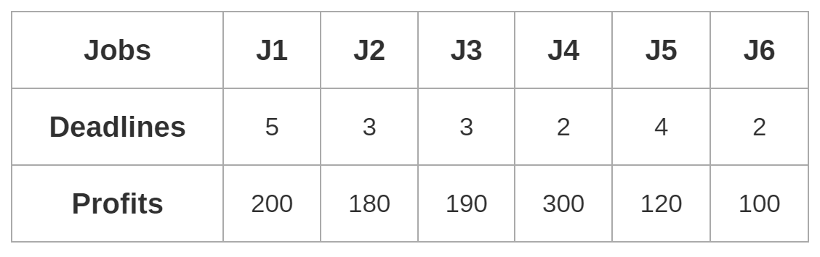

Example
Problem- Given the following jobs, their deadlines and associated profits as shown-
Answer the following questions-
Write the optimal schedule that gives maximum profit.
Are all the jobs completed in the optimal schedule?
What is the maximum earned profit?

Slide 5
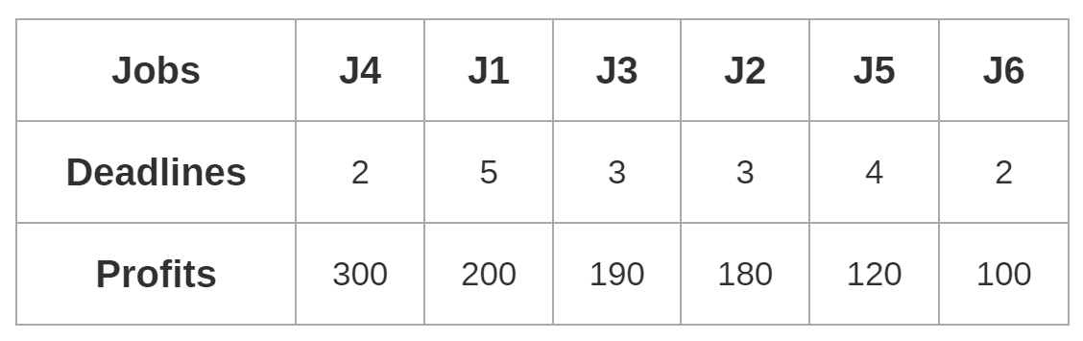

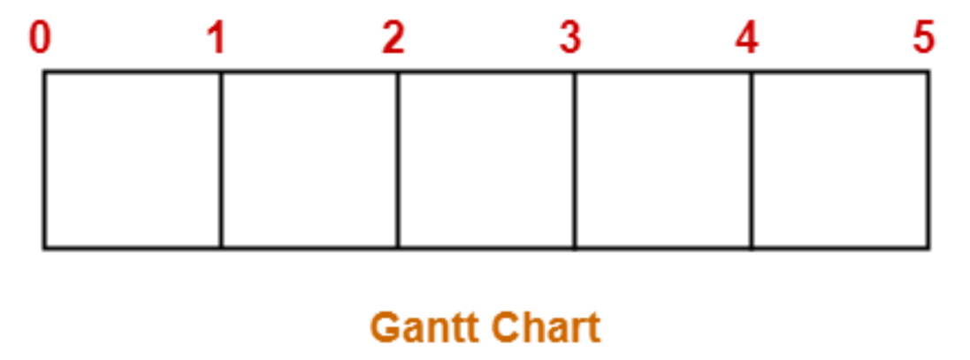
Solution
Value of maximum deadline = 5

Slide 6
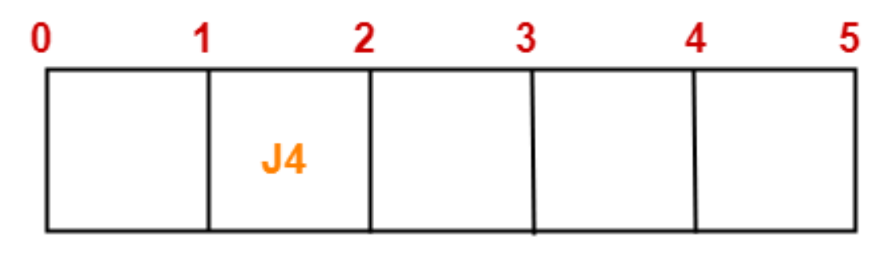
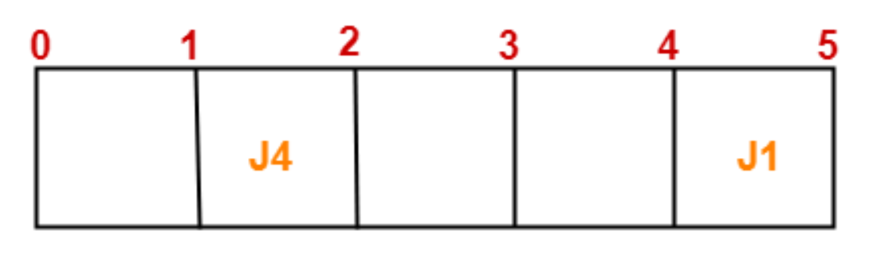
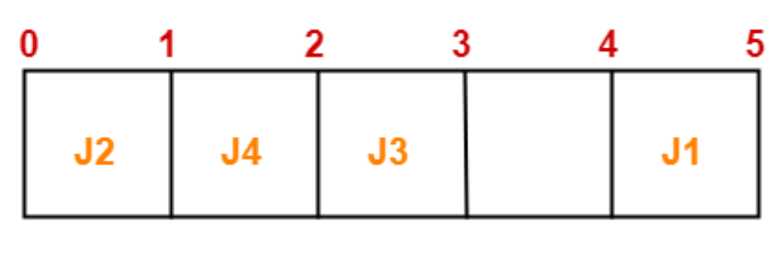
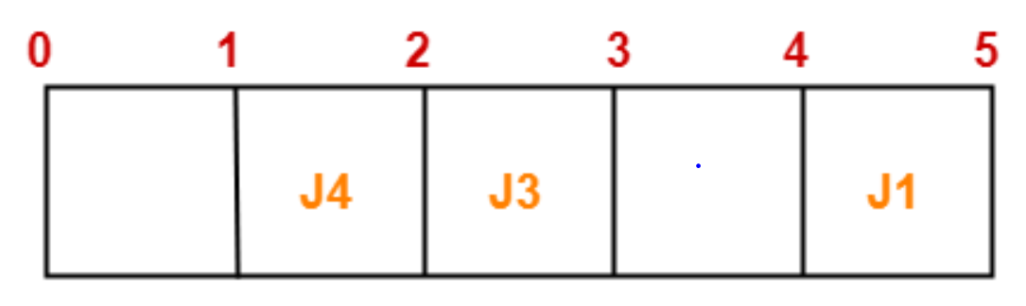

Slide 7
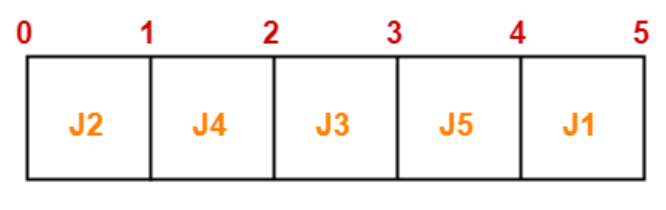
Final Solution
Ans 1: Optimal solution is:
Ans 2: All the jobs are not completed in the optimal schedule.
This is because job J6 could not be completed within its deadline.
Ans 3: Maximum earned profit = Sum of profits of all jobs in optimal schedule
= Profit of job J2 + Profit of job J4 + Profit of job J3 + Profit of job J5 + Profit of job J1
= 180 + 300 + 190 + 120 + 200 = 990 units

Slide 8
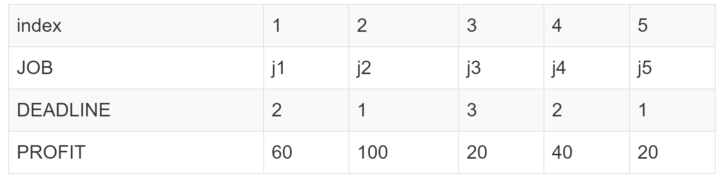
In class Practice
Problem: Consider the following 5 jobs and their associated deadline and profit.
Goal: The objective is to earn maximum profit when only one job can be scheduled or processed at any given time.

Slide 9
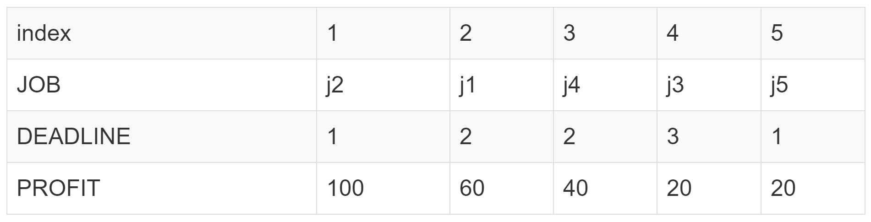
Step 1
Sort the jobs according to their profit in descending order.

Slide 10
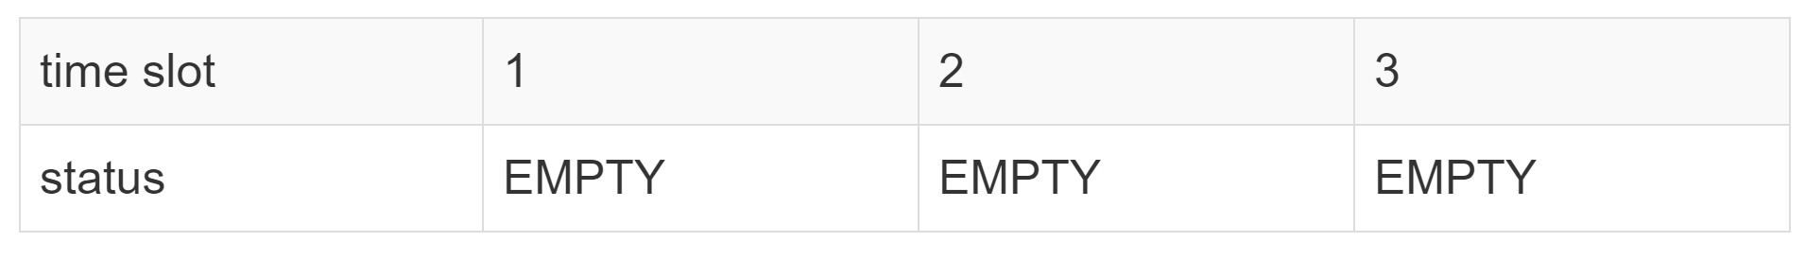
Step 2
Find the maximum deadline value dmax = 3

Slide 11

Step 3
Job j2 has a deadline 1. This means we have to complete job j2 in time slot 1 if we want to earn its profit.
Similarly, if we look at job j1 it has a deadline 2. This means we have to complete job j1 on or before time slot 2 in order to earn its profit.
Similarly, if we look at job j3 it has a deadline 3. This means we have to complete job j3 on or before time slot 3 in order to earn its profit.
Required Jobs: j2 --> j1 --> j3
Max Profit: 180

Slide 12
Minimum Spanning Trees
Minimum Spanning Tree
It is Acyclic
It covers all the vertices V and contains |V| - 1 edges.
Not necessarily unique
The total cost of tree edges is the minimum among all possible spanning trees.

Slide 13
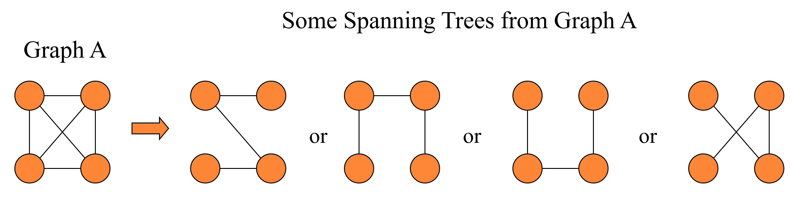
Spanning Trees

Slide 14
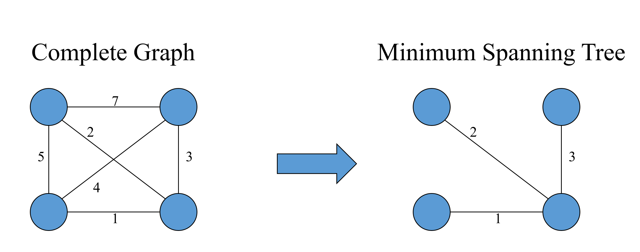
Minimum Spanning Tree

Slide 15
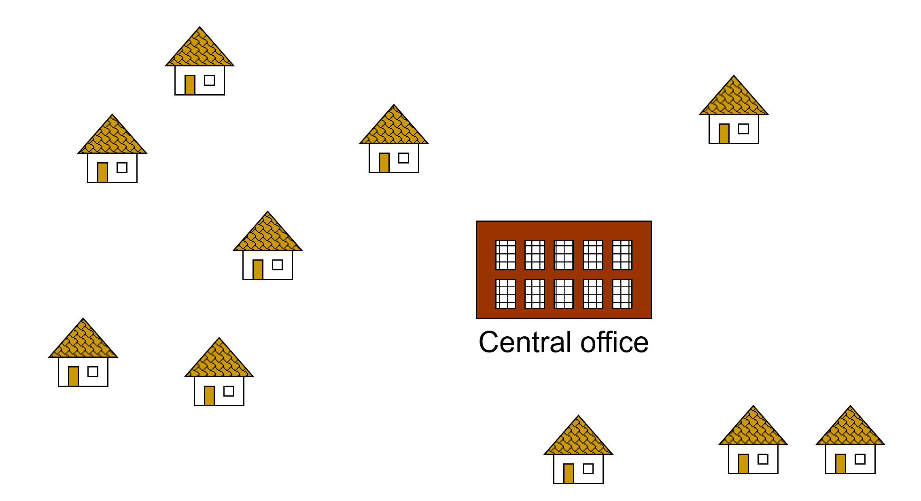
Problem: Laying Telephone Wire

Slide 16
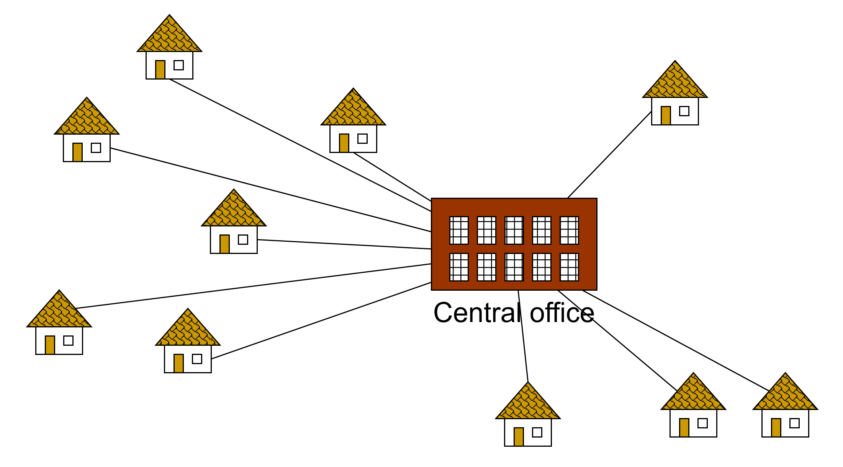
Wiring: Naive Approach
Expensive!

Slide 17
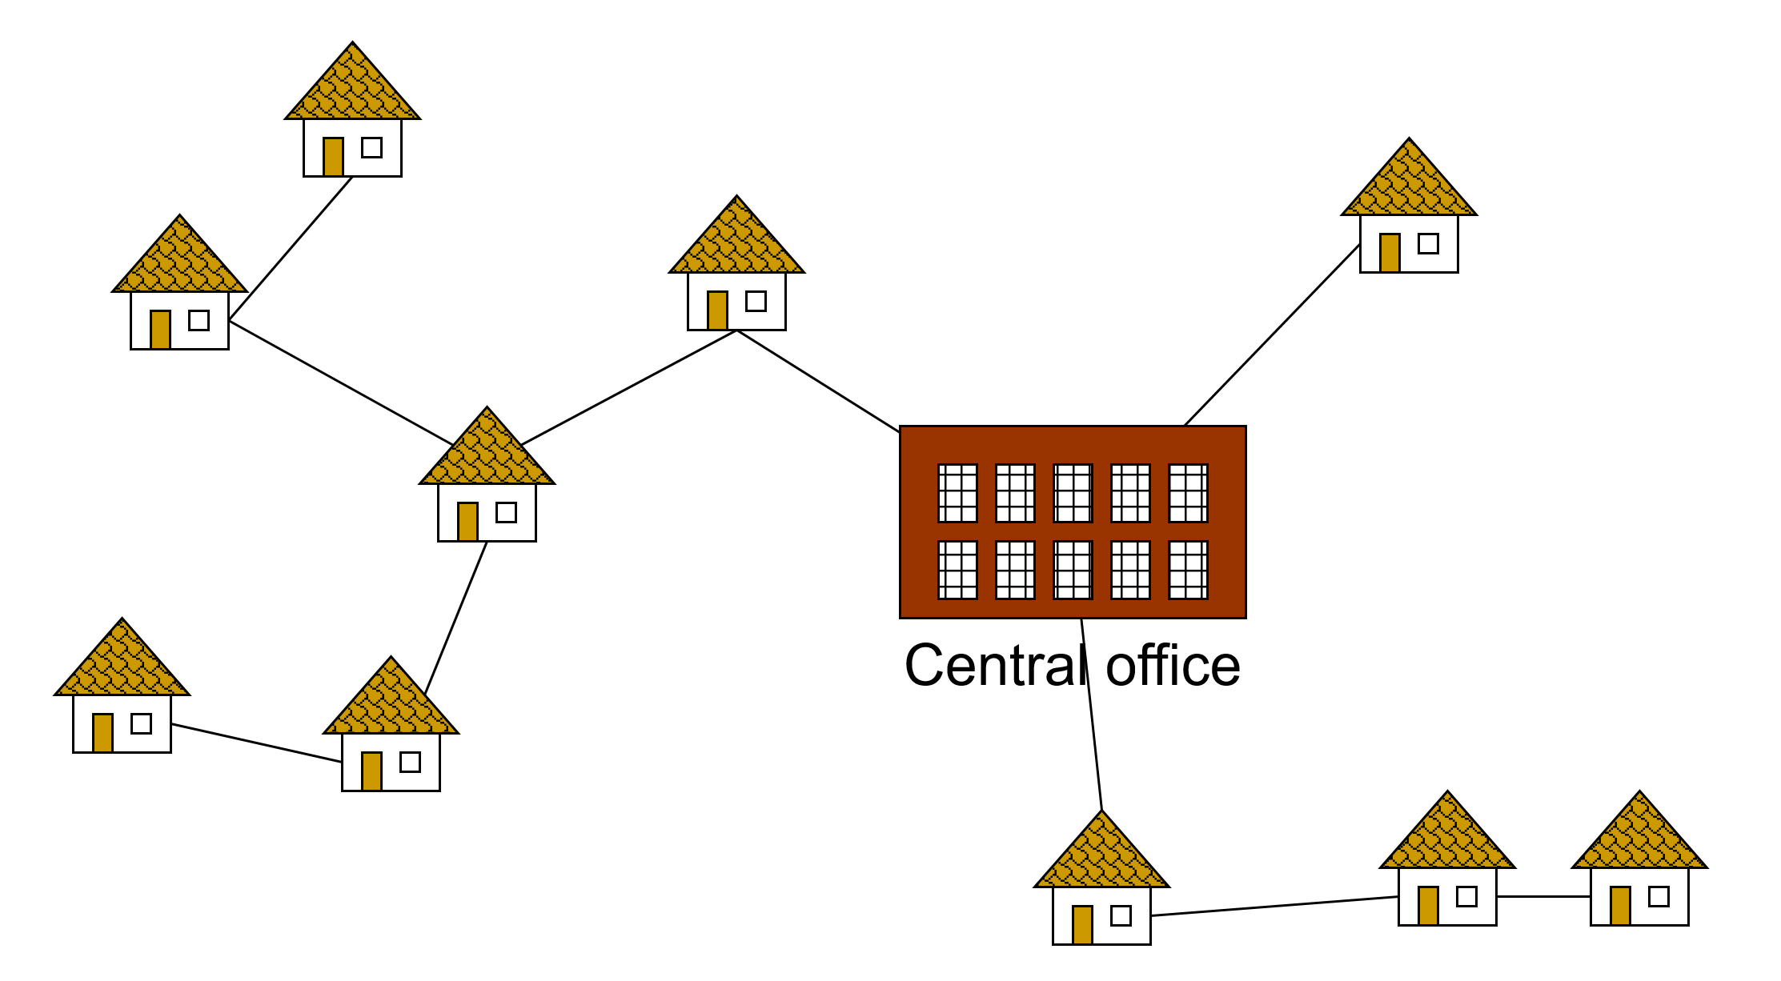
Wiring: Better Approach
Minimize the total length of wire connecting the customers

Slide 18
Approaches: Minimum spanning trees
Prims
Kruskals

Slide 19
Prim’s Algorithm
1. Initialization:
a. Pick a vertex r to be the root
b. Set D(r) = 0, parent(r) = null
c. For all vertices v ∈ V, v ≠ r, set D(v) = ∞
d. Insert all vertices into priority queue P, using distances as the keys.
9
b
Vertex Parent
e -
a
2
6
d
e
a
b
c
d
4
5
5
4
0
∞
∞
∞
∞
5
e
c

Slide 20
Prim’s Algorithm
2. While P is not empty:
2.1 Select the next vertex u to add to the tree
u = P.deleteMin()
2.2 Update the weight of each vertex w adjacent to u which is not in the tree(i.e.w∈P)
If weight(u,w) < D(w),
a. parent(w) = u
b. D(w) = weight(u,w)
c. Update the priority queue to reflect new distance for w

Slide 21
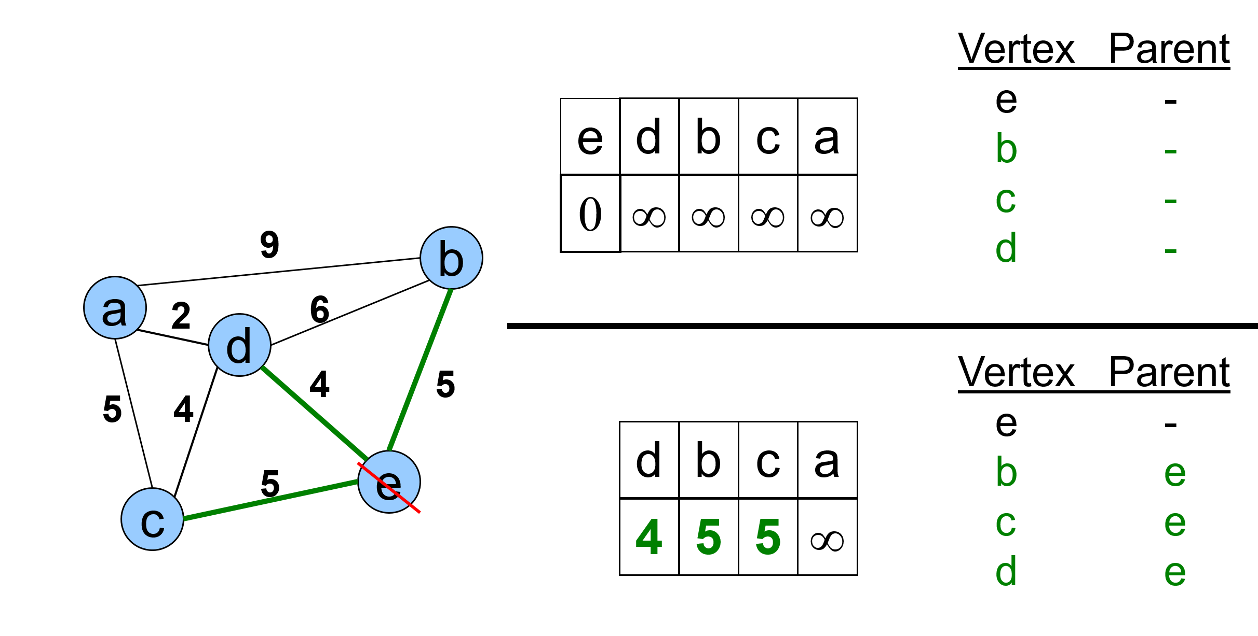
Example: Prim’s Algorithm
The MST initially consists of the vertex e, and we update the distances and parent for its adjacent vertices.

Slide 22
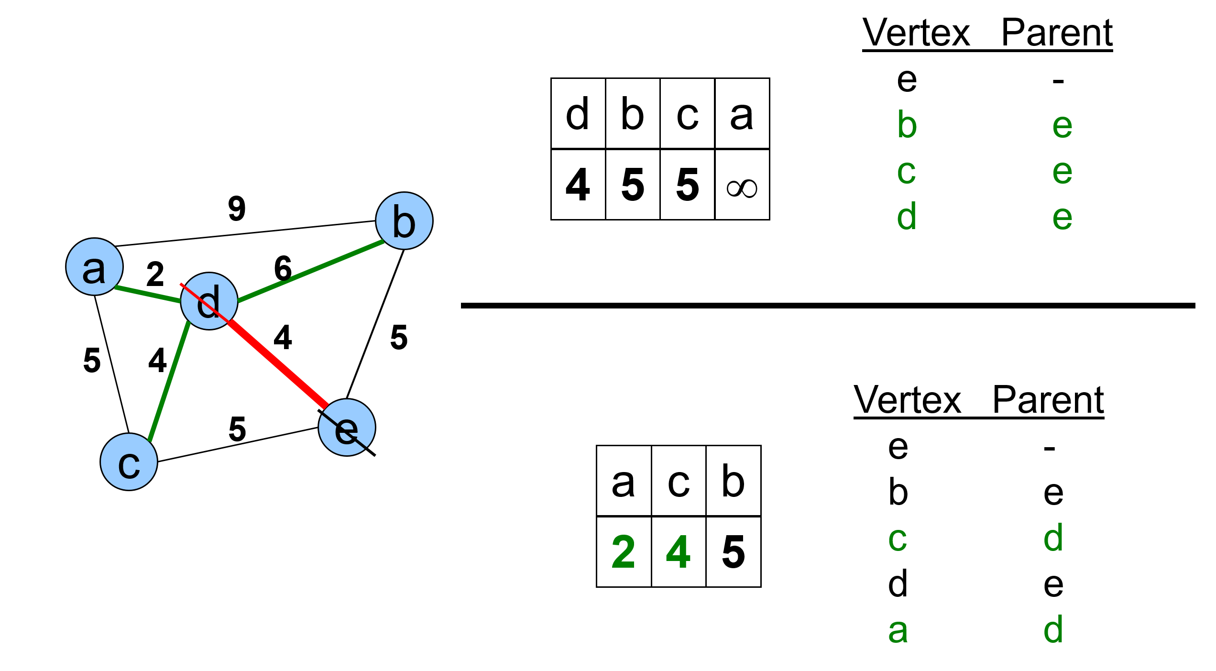
Example: Prim’s Algorithm

Slide 23
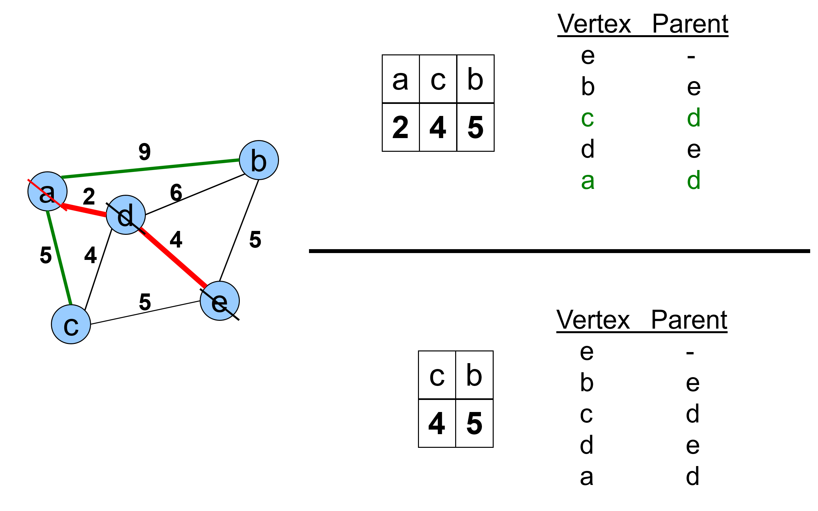
Example: Prim’s Algorithm

Slide 24
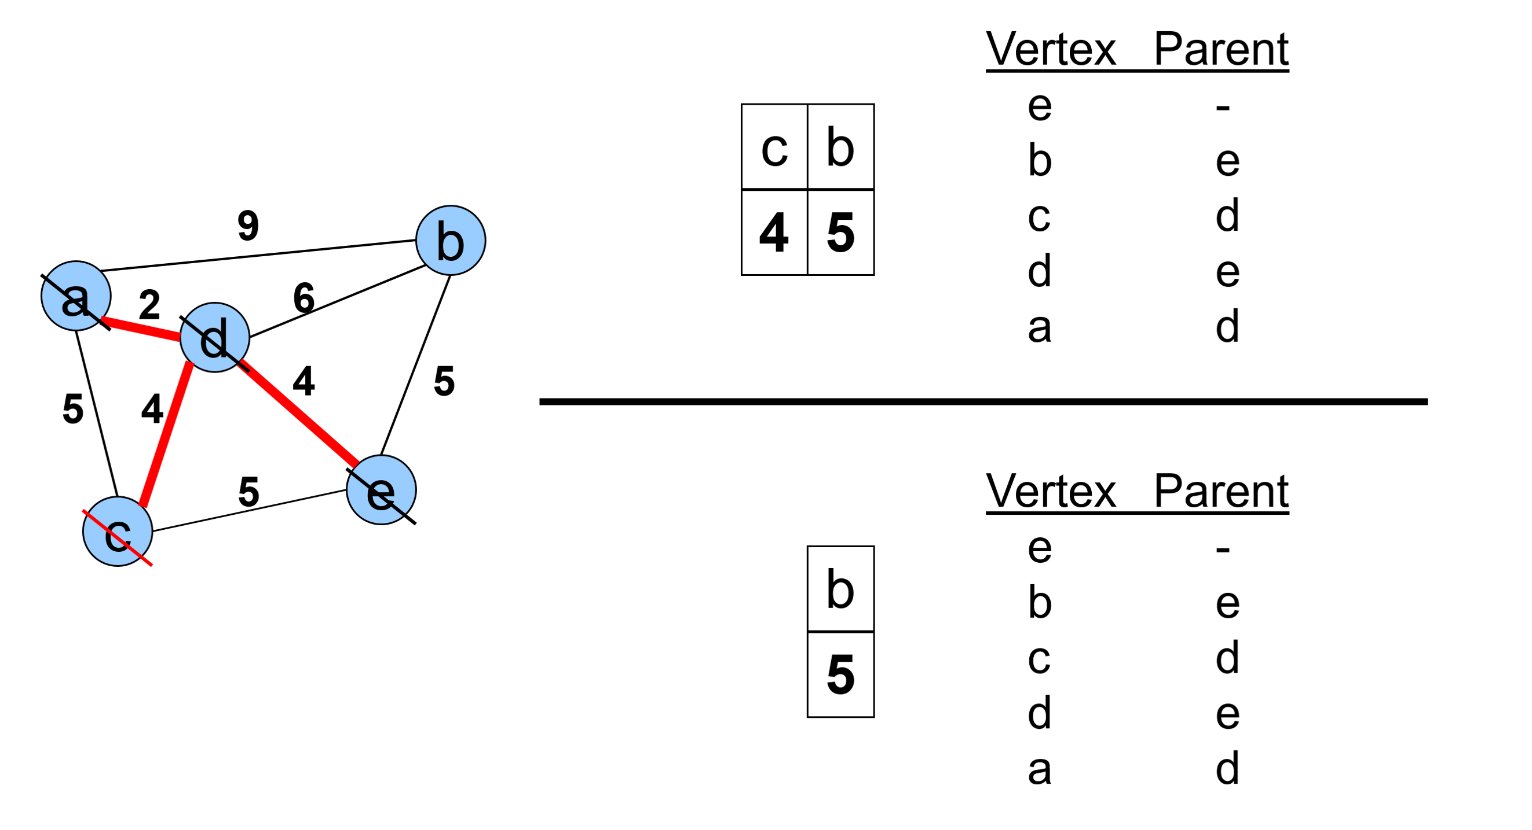

Slide 25
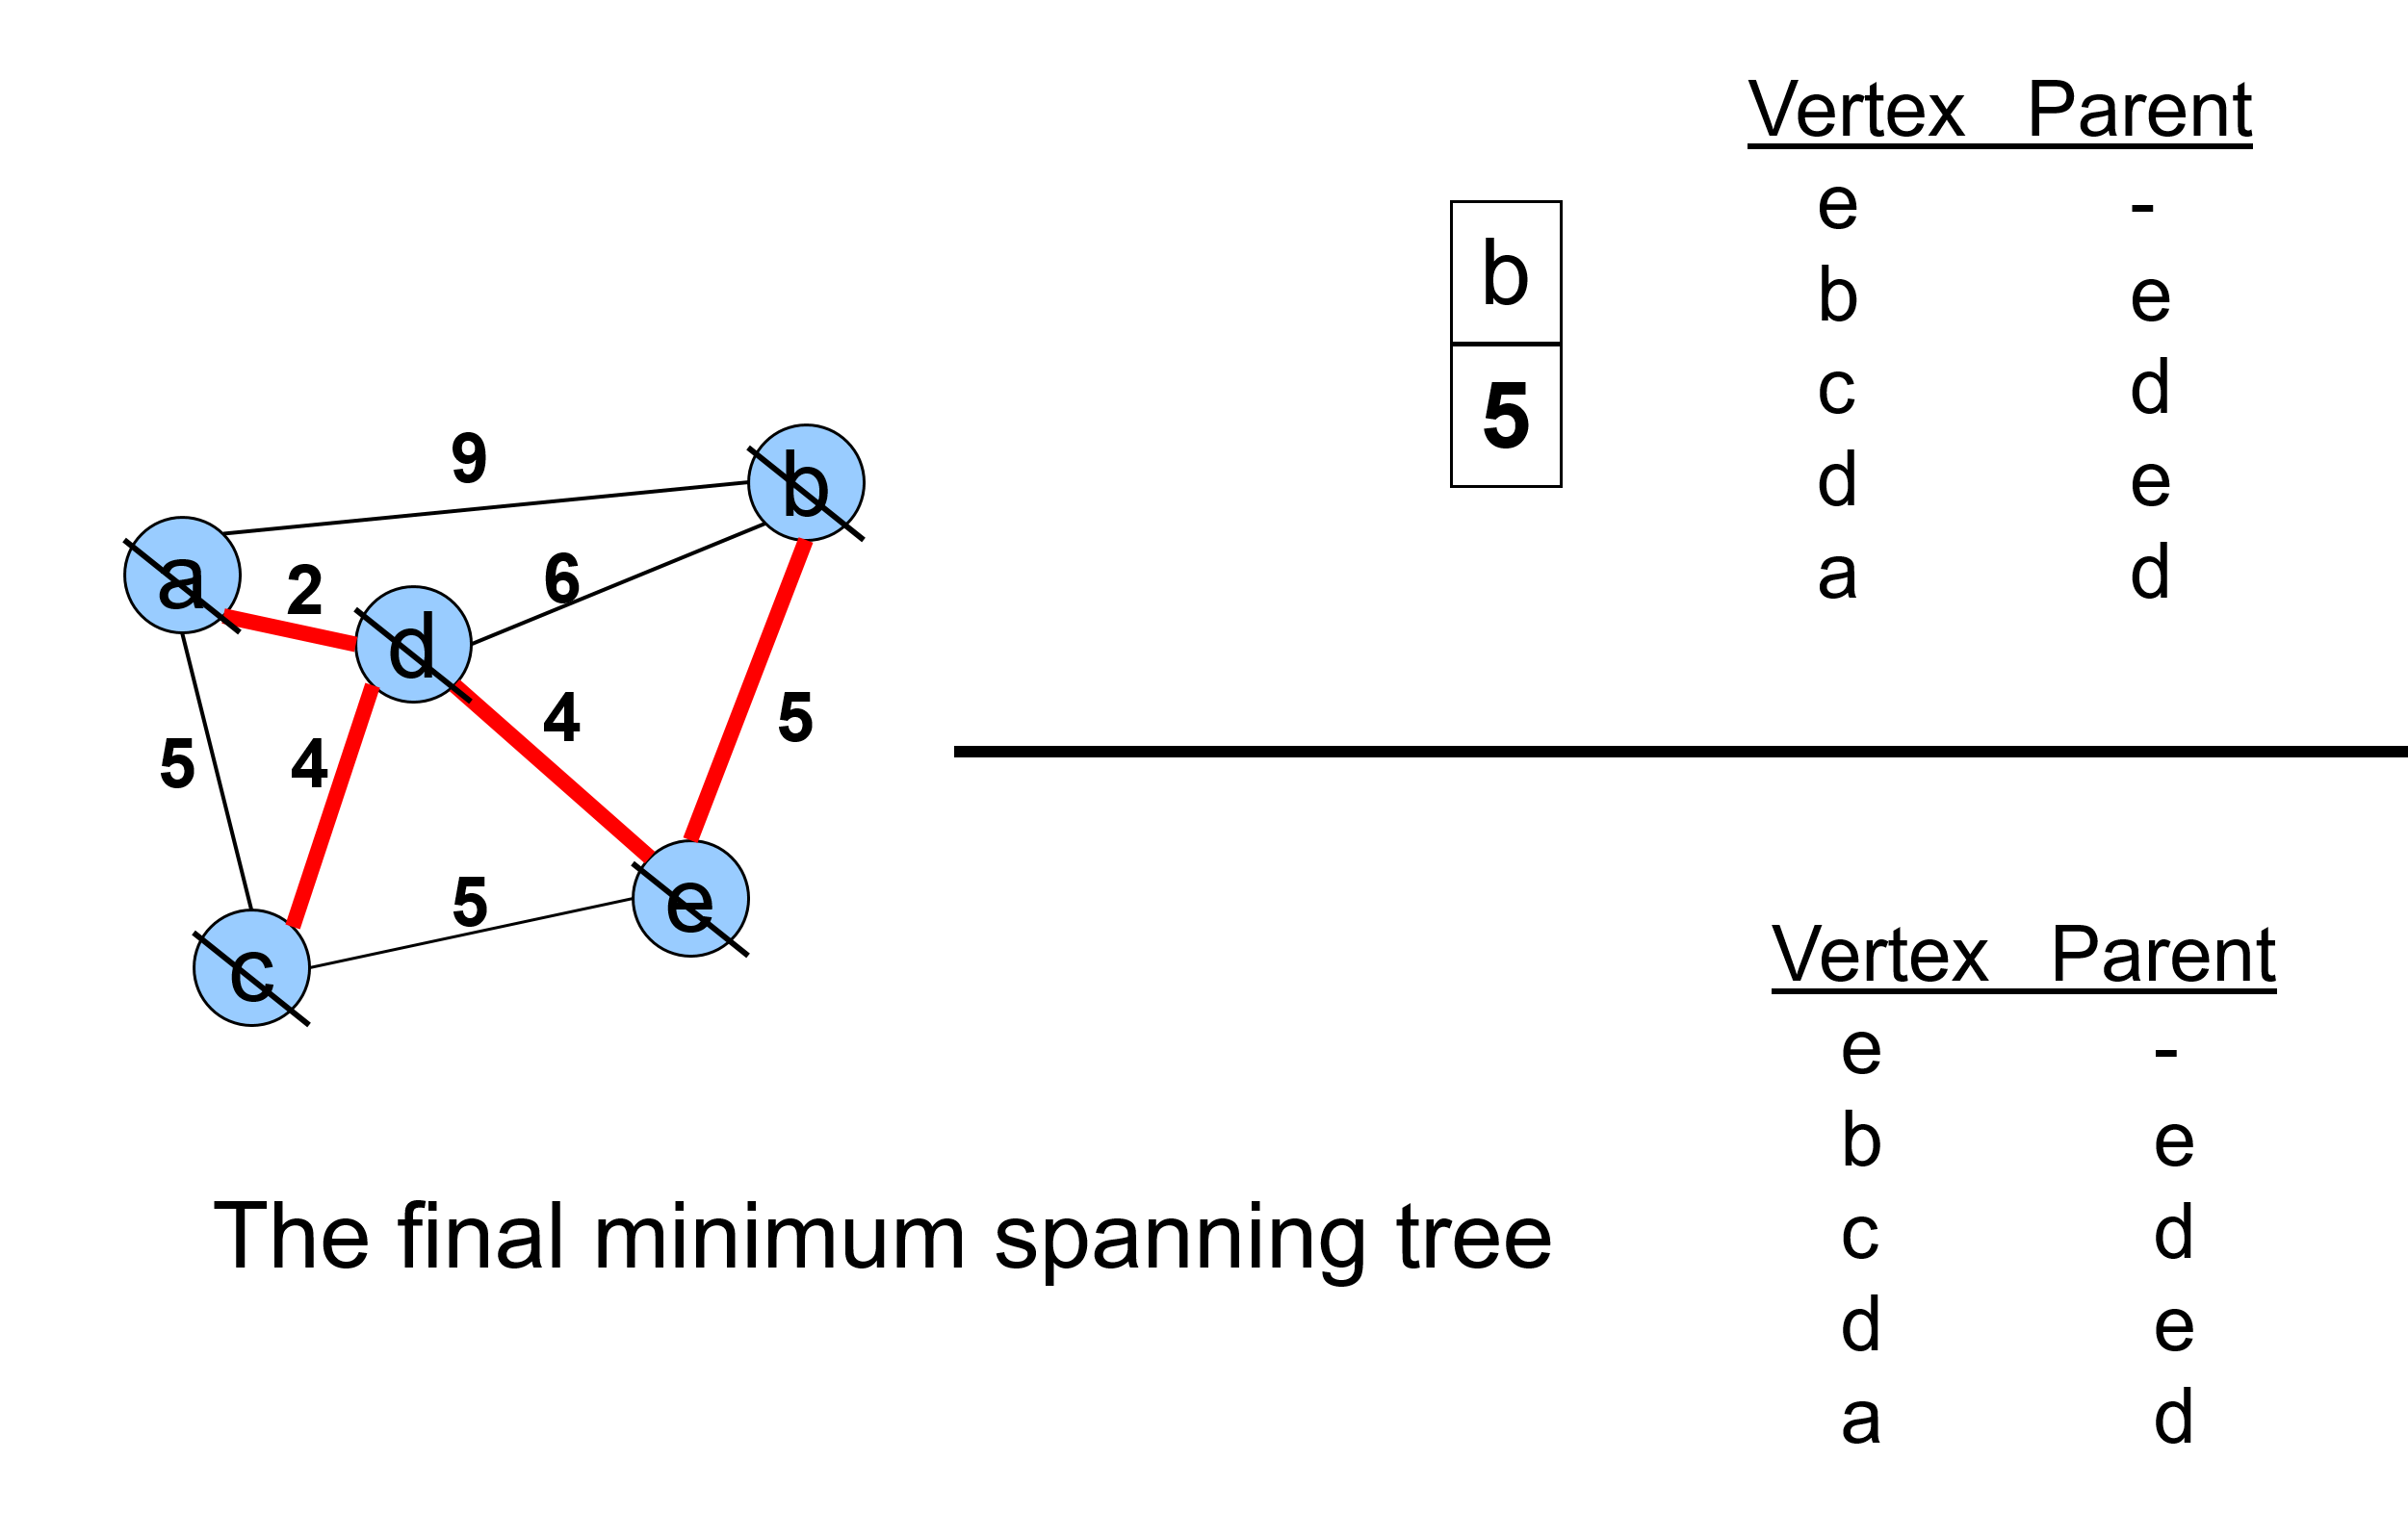
Example: Prim’s Algorithm

Slide 26

Complexity analysis: Prims Algorithm
Initialization of priority queue (array): O(|V|)
Update loop: |V| calls
Choosing vertex with minimum cost edge: O(|V|)
Updating distance values of unconnected vertices: each edge is considered only once during entire execution, for a total of O(|E|) updates.
Overall cost :
O(|E| + |V| ²)

Slide 27
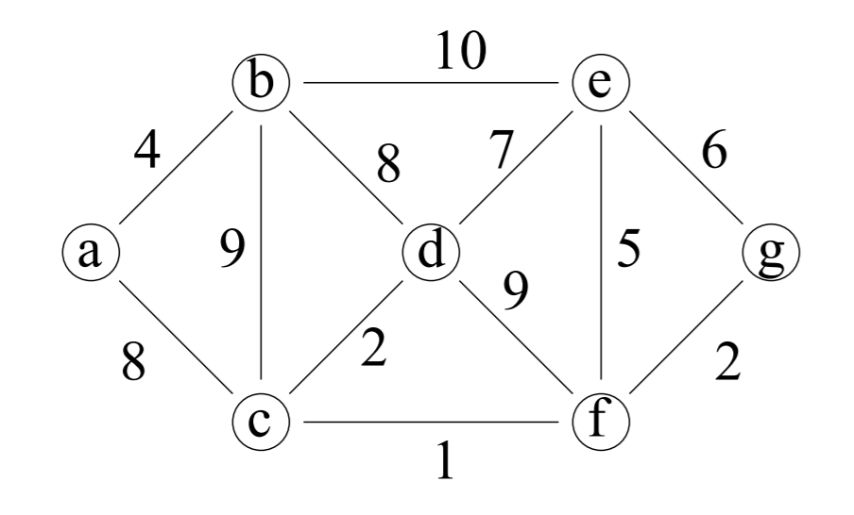

In Class Practice question
Ques: Construct the Minimum spanning tree for the following graph using Prims algorithm considering a as the root vertex.

Slide 28
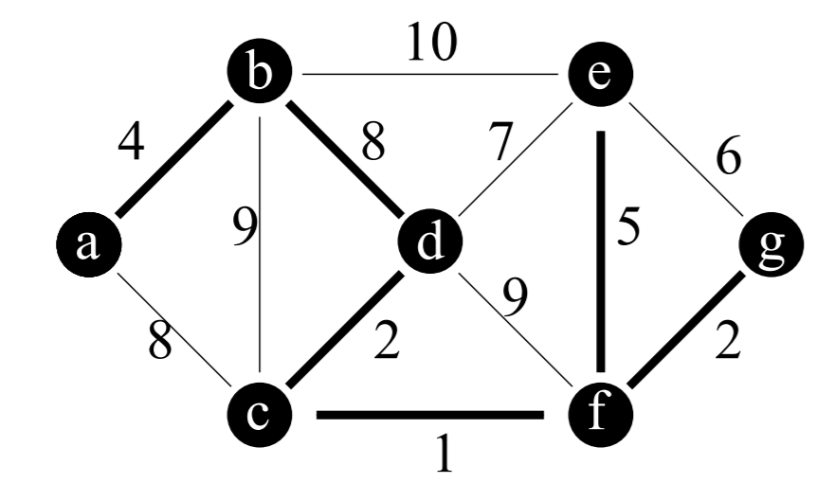
Solution
A={{a,b},{b,d},{c,d},{c,f}, {f,g},{f,e}}
Total cost = 4+8+2+1+2+5 = 23

